Slide 1

PHISHING ATTACK
PRESENTED BY: LAÏLA HAMMOUCH

Slide 2

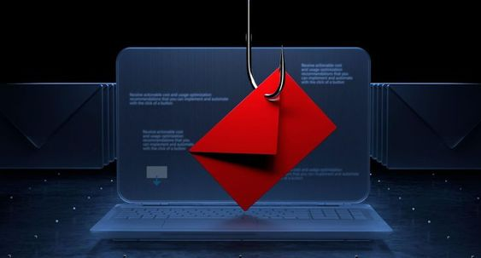
WHAT IS PHISHING ATTACK?
A type of cybercrime where attackers attempt to trick individuals into revealing personal or confidential information.

Slide 3
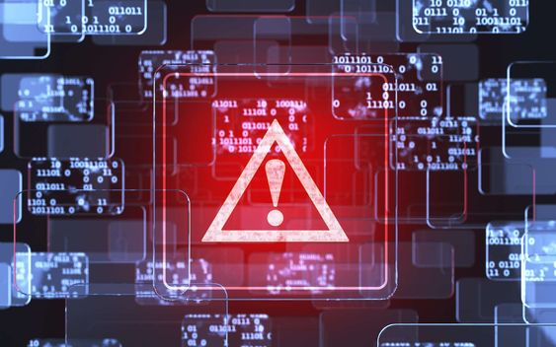
WHY IS PHISHING A PROBLEM?
1
Data breaches:
Phishing can lead to large-scale data breaches, exposing the personal information of millions of people.
2
Financial loss:
Victims of phishing attacks often suffer financial losses due to unauthorized transactions, fraudulent charges, and identity theft.
3
Reputation damage:
Businesses that experience a data breach due to a phishing attack can suffer significant reputational damage.

Slide 4
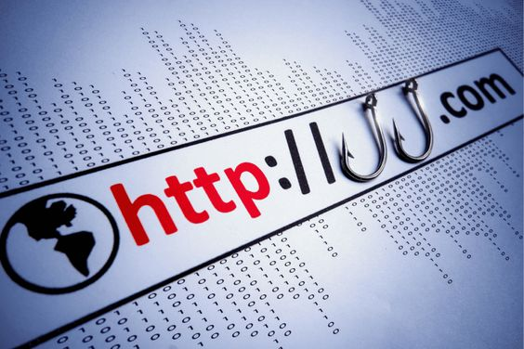
TYPES OF PHISHING ATTACKS
Email phishing:
Smishing:
Spear Phishing:
02
03
Targeted attacks aimed at specific individuals or organizations
01
The most common type, often disguised as legitimate emails from trusted sources
Phishing via text message.
vishing:
Whishing:
05
Phishing via voice call.
04
Phishing through social media platforms.

Slide 5
Suspicious URLs: Look for typos, unusual domains, or shortened links.
HOW TO RECOGNIZE A PHISHING ATTEMPT
Grammar and Spelling Errors: Phishing emails often contain grammatical or spelling mistakes.
Urgent Requests: Phishing emails often create a sense of urgency, urging immediate action.
Suspicious Attachments: Be cautious of unexpected attachments, especially if they have unusual file extensions

Slide 6

PHISHING TACTICS
Social Engineering: Manipulating people into revealing sensitive information.
Fear and Intimidation: Creating a sense of urgency or threat to pressure victims.
Gift Scams: Offering fake prizes or discounts to lure victims.
Impersonation: Pretending to be someone you trust or know.

Slide 7

Be Skeptical:
Don't trust unsolicited emails or messages, even if they appear to be from legitimate source
HOW TO PROTECT YOURSELF
Verify Information:
Double-check the sender's email address and contact information.
Use Strong Passwords:
Create unique and complex passwords for all your online accounts.
Enable Two-Factor Authentication:
Add an extra layer of security to your accounts.
Keep Your Software Updated:
Install the latest security patches for your operating system and application
Educate Yourself:
Stay informed about the latest phishing scams and techniques.

Slide 8
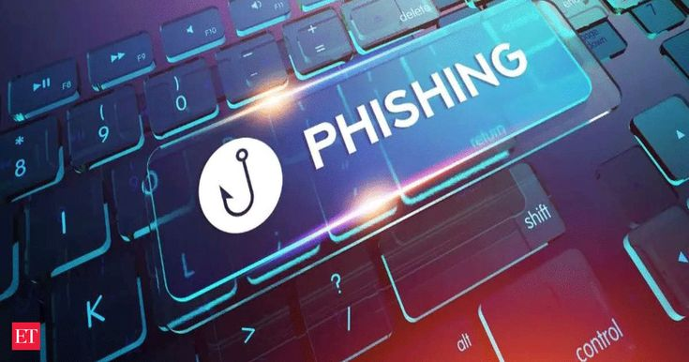
Phishing is a constant threat. It's essential to be vigilant and aware of common phishing tactics.And By understanding phishing attacks and taking proactive steps to protect yourself, you can help keep your personal information safe.
CONCLUSION

